Slide 1
Instrumentation Amplifier

Slide 2
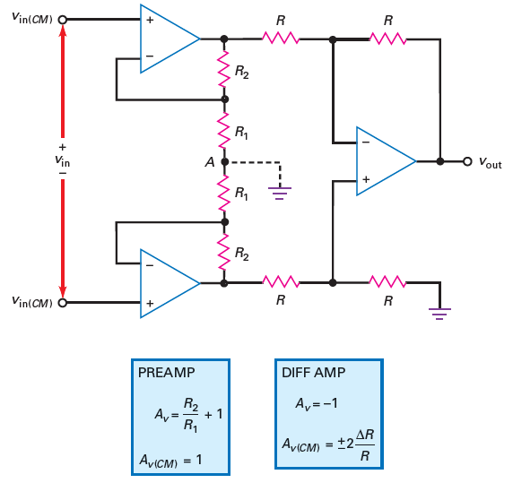
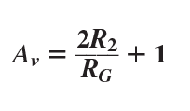
Instrumentation amplifier
Lecture 34

Slide 3
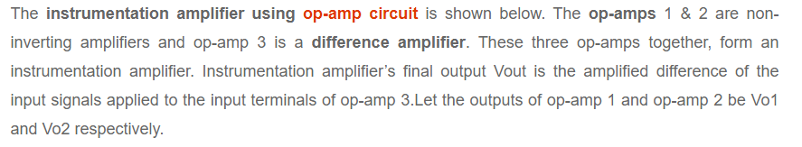
Working

Slide 4
Thank You

